Slide 1


Adventure works project

Slide 2
TEAM MEMBERS
RIYA GUPTA
ABHILASH G.
AMAL A. M.
SARVADNYA THUBE
VIVEK SINGH BISHT

Slide 3
INTRODUCTION
Adventure Works is a manufacturing and retail business that produces a lot of sales data about different products, clients, geographical areas, and time periods. Nevertheless, significant business insights are not directly provided by the raw data kept in numerous tables.
This project's goal is to use Excel, SQL, Tableau, and Power BI to turn raw data into useful insights for analyzing sales performance and business trends. Finding key performance indicators (KPIs), comprehending consumer and product behavior, assessing regional performance, and monitoring time-based sales trends are the main objectives of the analysis.
Through interactive dashboards and clearly defined metrics, this project empowers stakeholders to make data-driven decisions.

Slide 4
KPI’S AND INSIGHTS
Key Performance Indicators (KPIs)
Products Purchased per Order :- 2
Average Order Value (AOV) :- 1.06K
Total Sales Revenue :- $29.4M
Production Cost :- $17.3M
Total Customers :- 18K
Total Profit :- 12.08M
Tax Amount :- $2.3M
Total Orders :- 28K
Insights
Sales peaked in 2013, then declined in 2014.
North America & USA lead total sales.
Bikes category dominates overall revenue.
Age group 50–75 contributes highest sales.
Weekday sales exceed weekend sales.
Male & female sales are nearly equal.

Slide 5
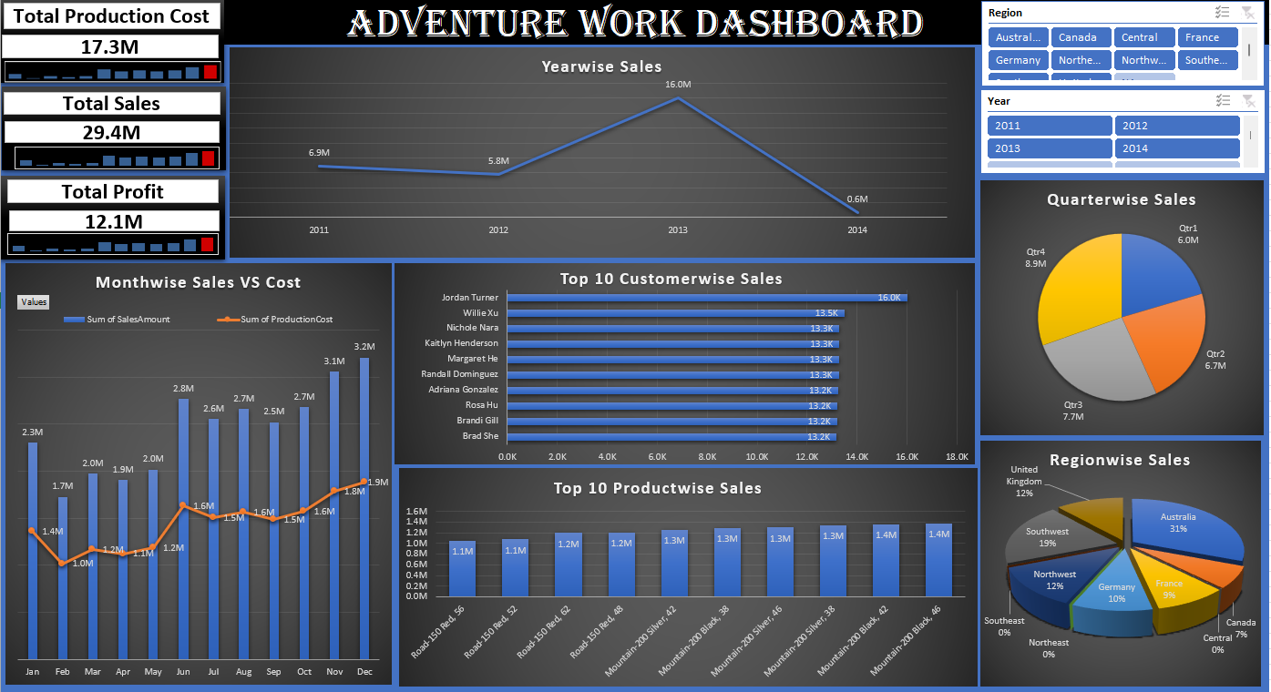
Excel Dashboard
Displays overall sales, profit, and production cost
Tracks year-wise, month-wise, and quarter-wise sales
Highlights top customers, top products, and region-wise sales
Enables interactive filtering by region and year

Slide 6
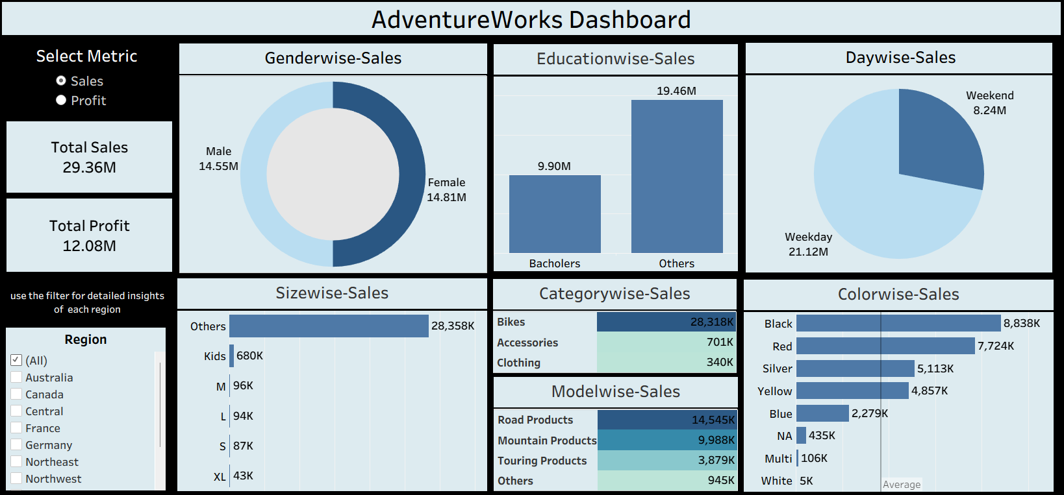
Tableau Dashboard
Focuses on customer demographics and behaviour
Analyses sales by gender, education, day type, size, and colour
Provides region-based filtering for deeper insights

Slide 7
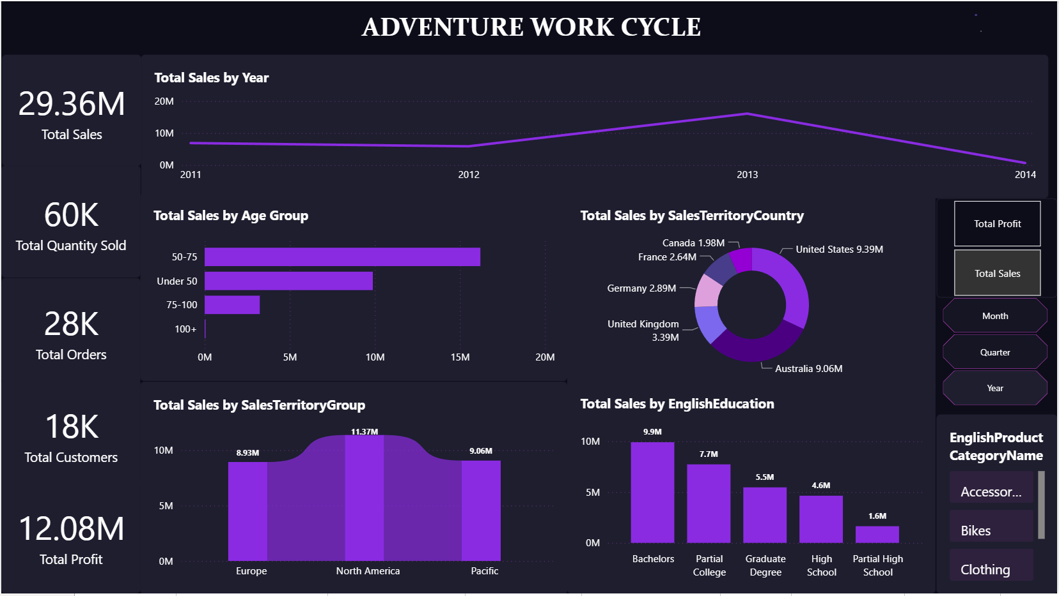
Power BI Dashboard
Presents interactive KPIs and time-based trends
Shows sales by year, territory, age group, and education
Uses dynamic slicers and DAX measures

Slide 8




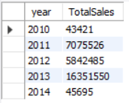
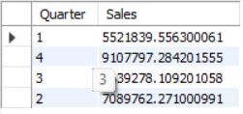
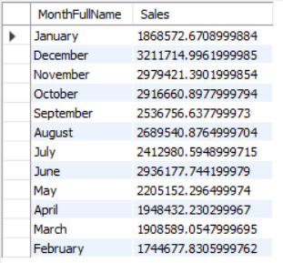
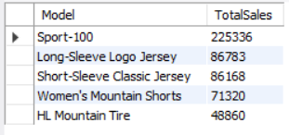
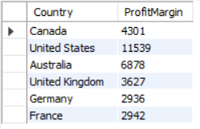
SQL Queries output
TOTAL SALES
TOTAL ORDERS
TOTAL PROCUCTION COST
GENDERWISE SALES
YEARWISE SALES
QUARTERWISE SALES
MONTHWISE SALES
TOP 5 MODELS WISE SALES
COUNTRYWISE PROFIT

Slide 9
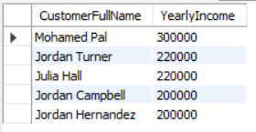
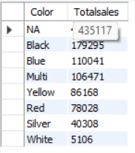
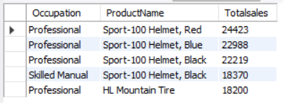
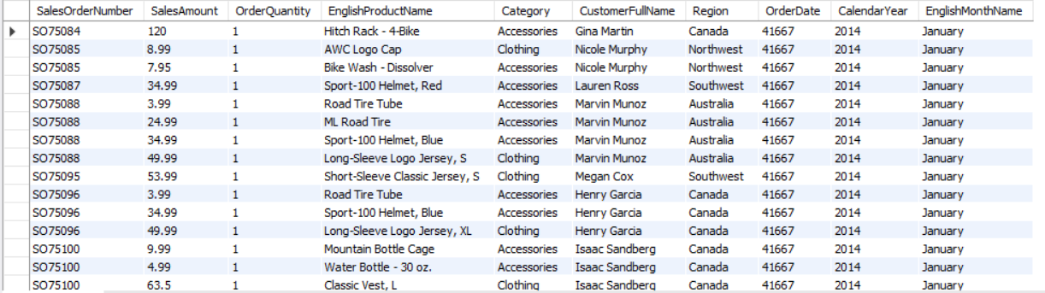
SQL QUERIES OUTPUT
TOP 5 CUSTOMER ON YEARLYINCOME
COLOURWISE SALES
TOP 5 OCCUPATION SALES
UNION VEIW OF DIFFERENT TABLES

Slide 10
summary
This project is based on the Adventure Works database, integrating multiple tables related to sales, customers, products, dates, and regions.
Data was cleaned, transformed, and analysed using MySQL queries to generate meaningful KPIs such as total sales, profit, quantity sold, and customer count.
Complex SQL queries enabled time-based, region-wise, product-wise, and customer-wise analysis.
The processed data was visualized using interactive dashboards to track trends, patterns, and performance.
Dashboards provided insights into sales growth, cost vs profit, top products, customer segments, and regional performance.
Overall, the project demonstrates how database querying and BI dashboards together support data-driven business decisions.
Key Learnings
Strong understanding of relational databases and joins
Practical use of MySQL for business insights
Importance of data modelling and KPIs
Effective storytelling through dashboards and visual analytics

